Slide 1

Power aware protocol design on IOT framework.
By-
Dipro Soren
11700119034
Joydeep Kar
11700119114
Arijit Chakraborty
11700119033
Ankit Eugine Xess
11700119036

Slide 2
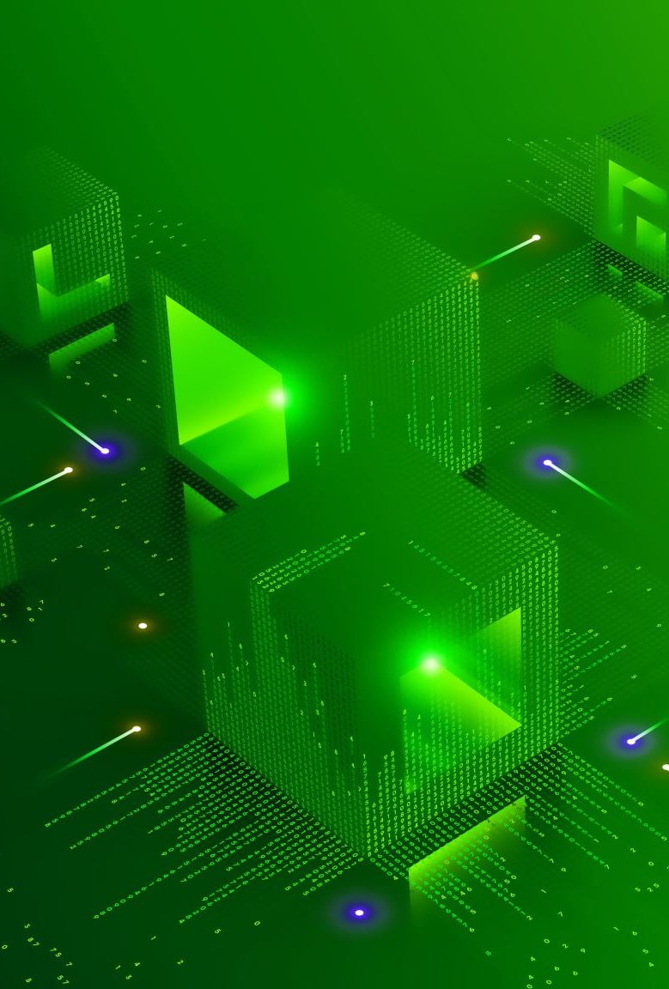
IOT : Internet of Things
THE Internet of Things (IoT) is an emerging communication paradigm that aims at connecting different kinds of objects to the Internet, in order to harvest data generated by sensors, remotely control appliances and machines, monitor environments, vehicles, and buildings, and so on
IoT allows objects to be sensed and controlled remotely across existing network infrastructure, creating opportunities for more direct integration between the physical world and computer-based systems, and resulting in improved efficiency, accuracy and economic benefit.

Slide 3
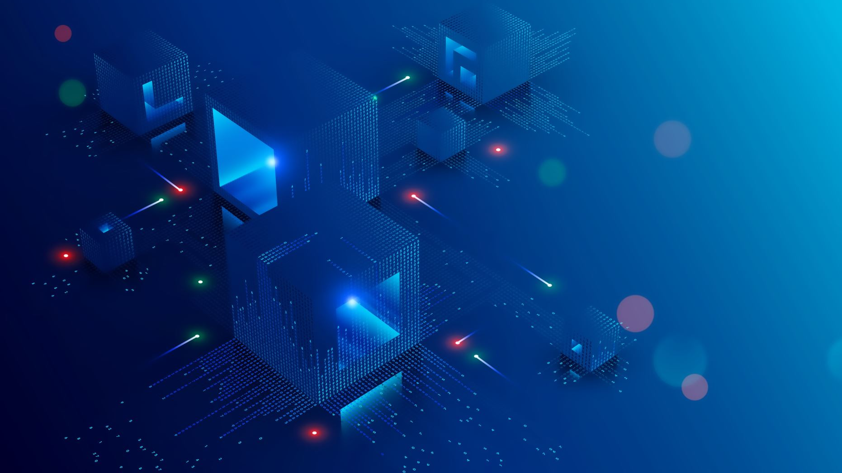
IoT Architecture:
IoT architecture is a framework that specifies the physical elements, network technical arrangement and setup, operating procedures, and data formats to be used. IoT architecture can differ greatly based on execution; it must be flexible enough for open protocols to handle many network applications.

Slide 4

There are 3 layers of IoT architecture:

Slide 5
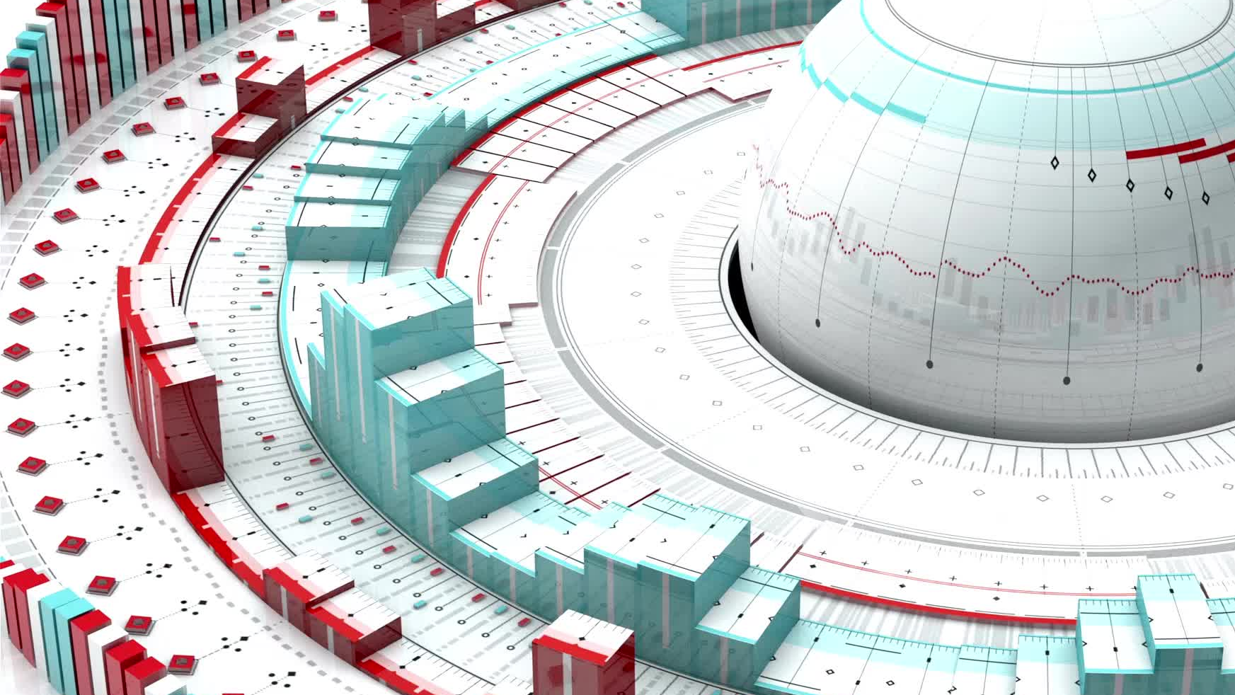
1. Perception Layer:
This perception layer is the IoT architecture’s physical layer. In this layer sensors and embedded systems are used mainly. These collect large amounts of data based on the requirements. This also includes edge devices, sensors, and actuators that communicate with the surroundings. It detects certain spatial parameters or detects other intelligent things /objects in the surroundings.
EXAMPLE: Sensor nodes , RFID sensors , Sensors Gateway.

Slide 6
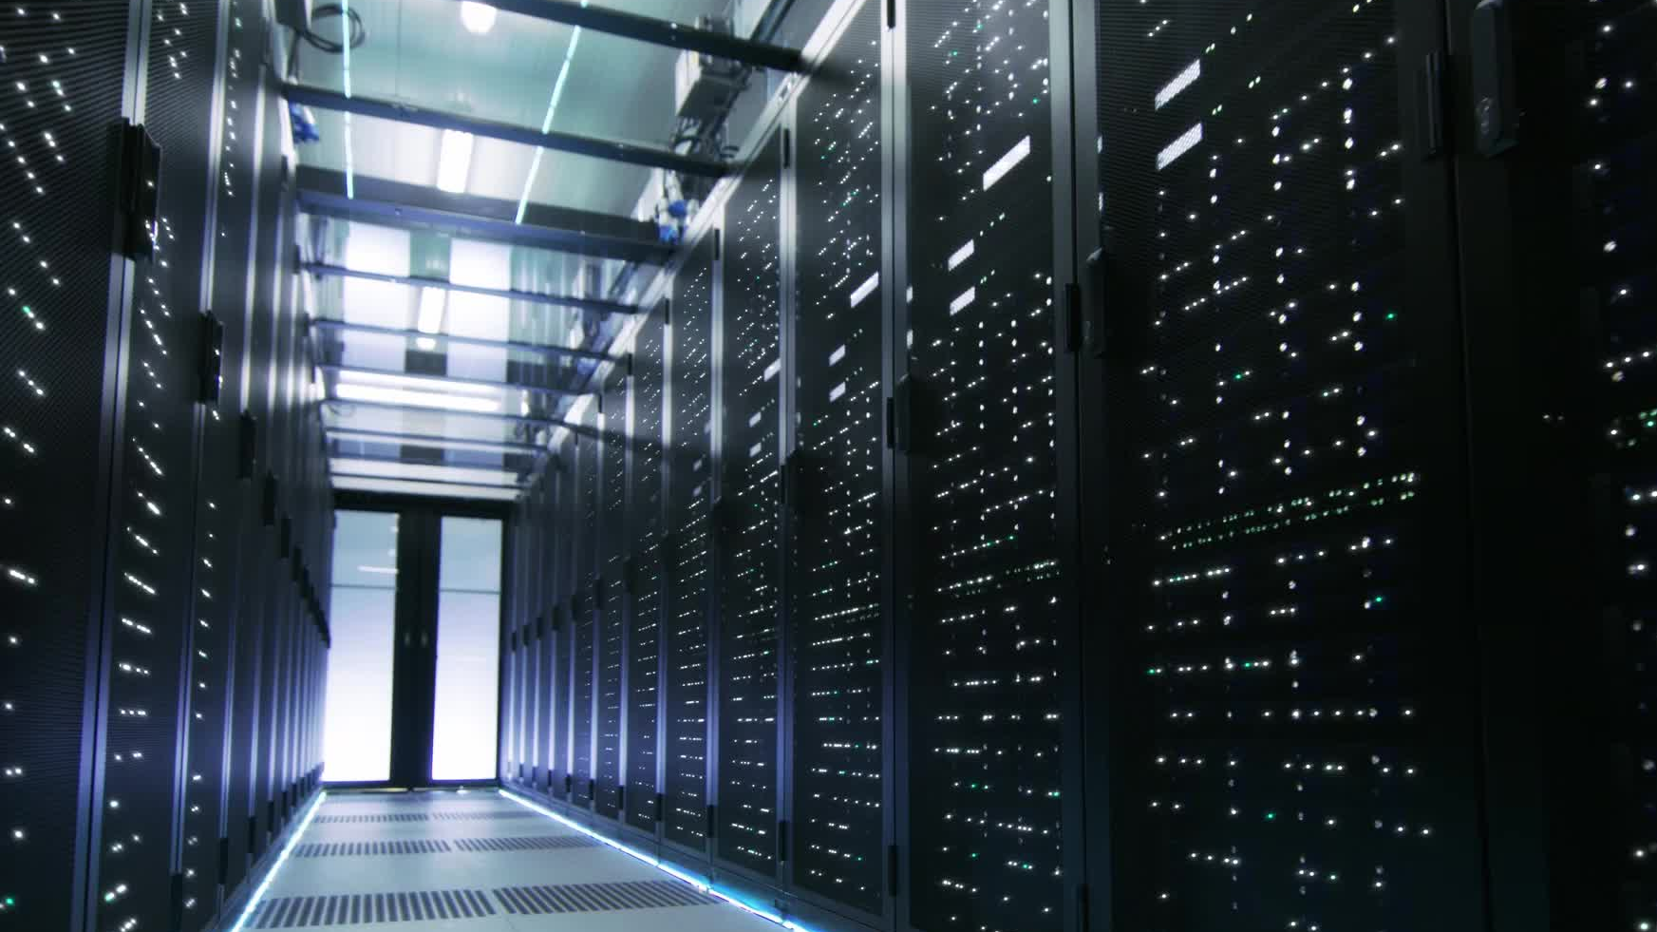
2. Network Layer:
The data obtained by these devices must be distributed and stored. This is the responsibility of the network layer. It binds these intelligent objects to other intelligent/ smart objects. It performs the data transfer. The network layer is incharge of linking smart objects, network devices, and servers. It is also used to distribute and analyse sensor data.
EXAMPLE: Internet , Cloud Computing , Mobile network , communication.

Slide 7

3. Application Layer:
The user communicates with this application layer. It is in-charge of providing the customer with software resources. Example: in smart home application, where users press a button in the app to switch on a coffee machine, for example. The application layer is in-charge of providing the customer with application-specific resources.
EXAMPLE: Television , Personal Computer , Mobile phone.

Slide 8
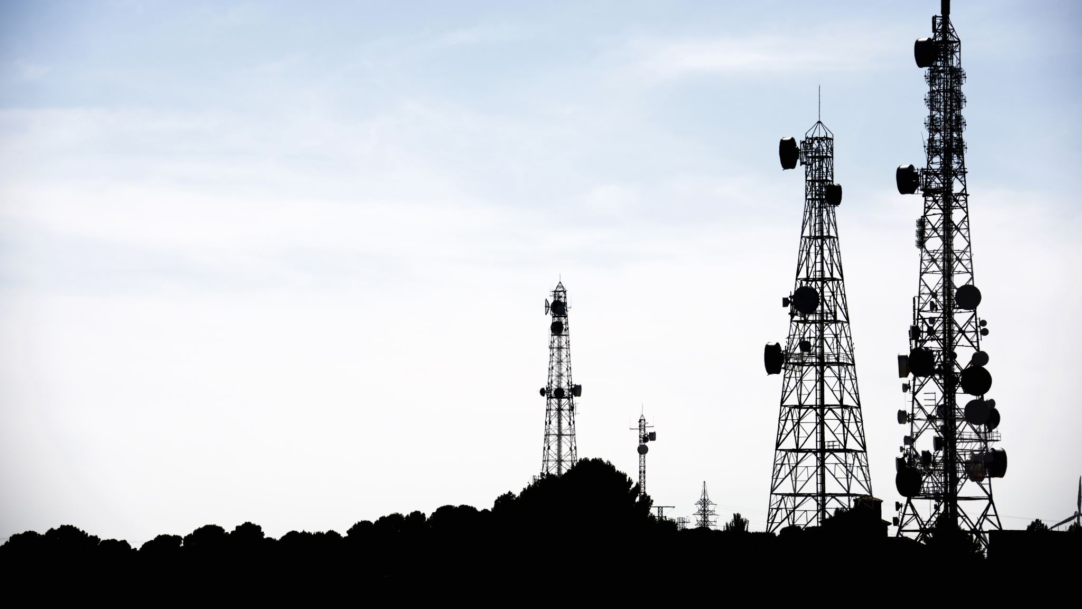
Basic IoT elements

Slide 9

Sensors:
They are very small devices or systems built to understand and detect the change in their environment and further streamline information in their system. Generally, these sensors are quite small and take even less power to perform their task. Sensors can detect physical parameters such as humidity or temperature and then transform them into electronic signals.

Slide 10
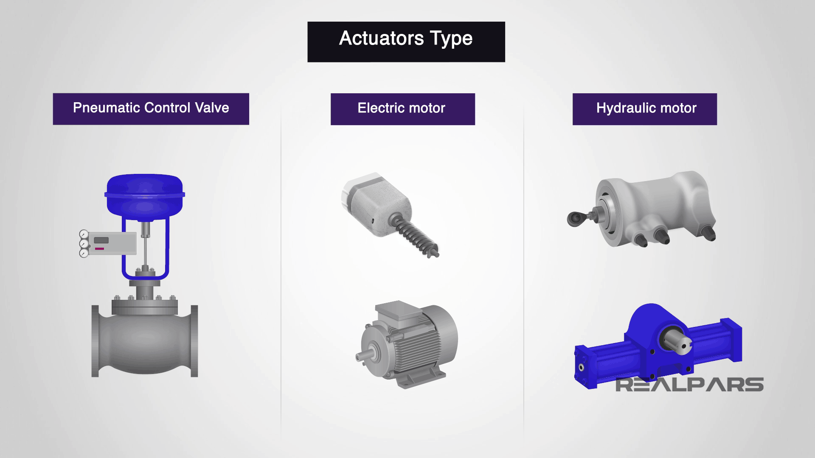
Actuators:
These represent a part of the machine that allows an electrical signal to be transformed into physical actions. These Actuators play a crucial role as components of IoT networks.

Slide 11
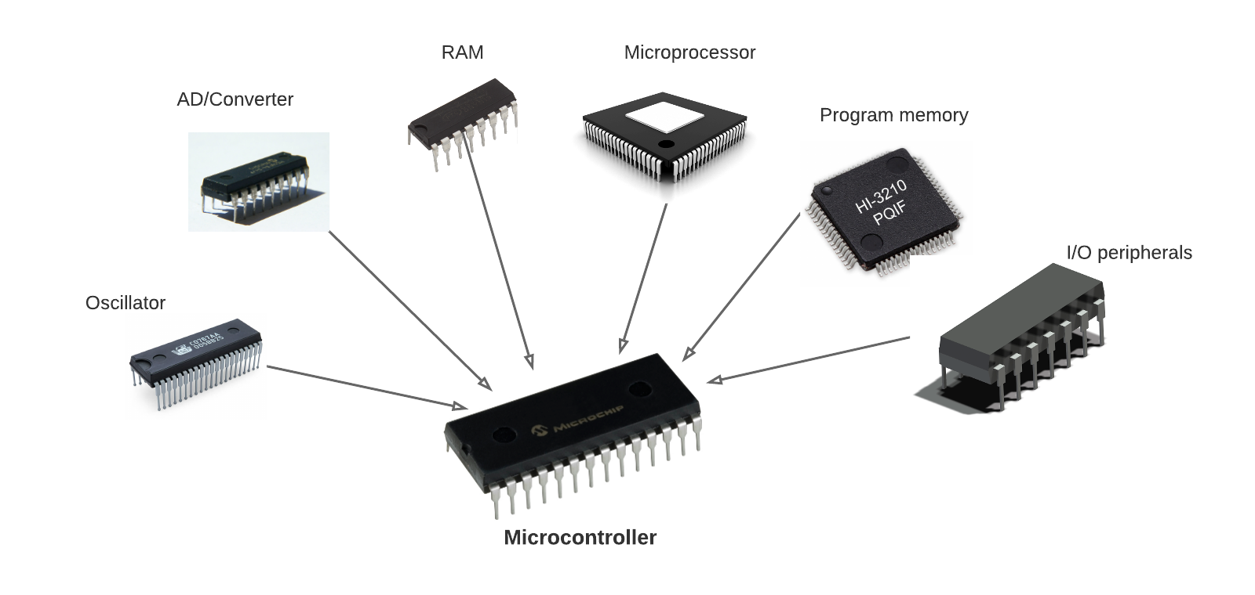
Microcontroller:
A microcontroller is a small and low-cost microcomputer, which is designed to perform the specific tasks of embedded systems like displaying microwave’s information, receiving remote signals, etc.

Slide 12
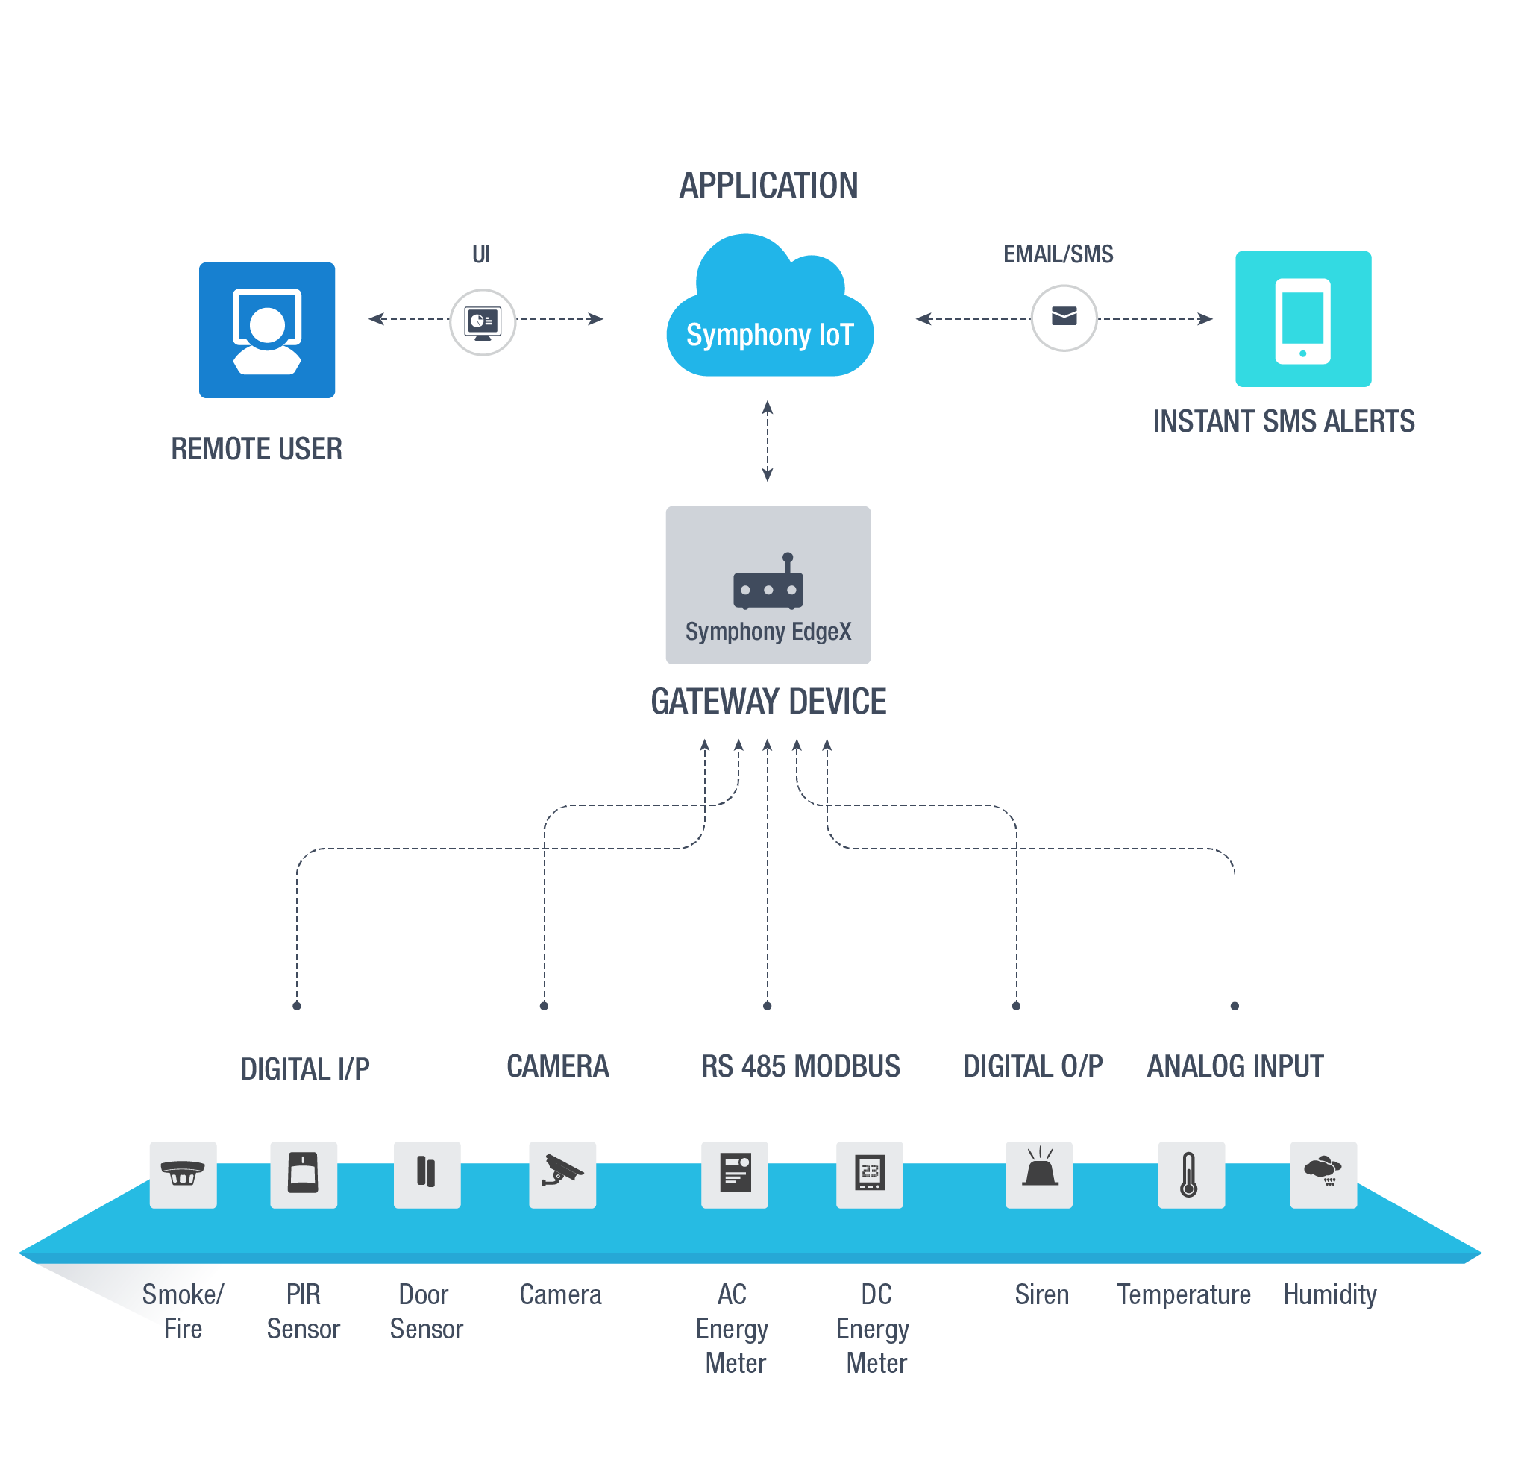
Communication unit:
A communication unit is an entity able to execute a communication scheme invoked through a procedure call mechanism.

Slide 13

Power supply
A power supply is an electrical device that supplies electric power to an electrical load. The main purpose of a power supply is to convert electric current from a source to the correct voltage, current, and frequency to power the load.

Slide 14

IoT Protocols

Slide 15

Message Queue Telemetry Transport (MQTT)
Designed to be lightweight, so it can work in very low bandwidth networks, MQTT allows communication between nodes in both reliable and unreliable networks. MQTT follows a publish/subscribe architecture, meaning that there are nodes (brokers) that make the information available, while others (clients) can read the available information after subscribing by accessing the corresponding URL.

Slide 16
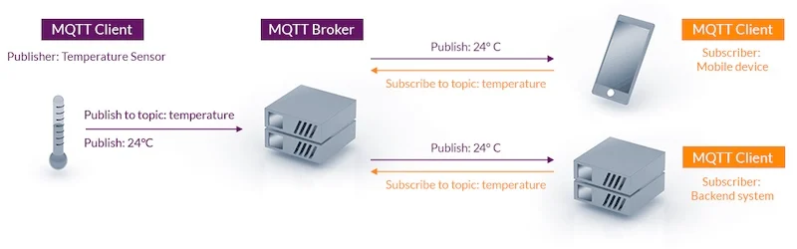
A use case of MQTT is in a smart factory where there are temperature sensors installed along with the production plant. The installed sensors will connect to the MQTT broker and will publish the data within sensor topics. Afterward, the MQTT clients, which can be of several types and quantities, will subscribe to the same topic in order to read the temperature data.

Slide 17

HyperText Transfer Protocol (HTTP)
The Hypertext Transfer Protocol (HTTP) is application-level protocol for collaborative, distributed, hypermedia information systems. It is the data communication protocol used to establish communication between client and server.
HTTP is TCP/IP based communication protocol, which is used to deliver the data like image files, query results, HTML files etc on the World Wide Web (WWW) with the default port is TCP 80. It provides the standardized way for computers to communicate with each other.

Slide 18
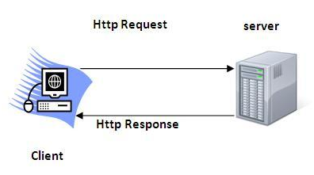
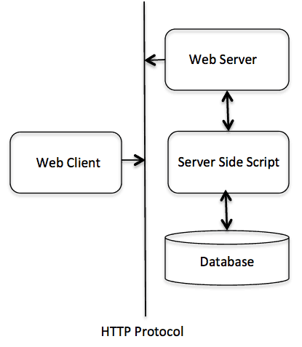
The Basic Characteristics of HTTP (Hyper Text Transfer Protocol):
It is the protocol that allows web servers and browsers to exchange data over the web.
It is a request response protocol.
It uses the reliable TCP connections by default on TCP port 80.
It is stateless means each request is considered as the new request. In other words, server doesn't recognize the user by default.
The diagram represents the basic architecture of web application and depicts where HTTP stands.

Slide 19

Constrained Application Protocol (CoAP)
CoAP is a web transfer protocol to be used with limited networks with low bandwidth and low availability. It follows a client/server architecture and is built similarly to HTTP, supporting the REST model: servers make resources available with an URL, and clients can make requests of types GET, POST, PUT and DELETE.
The CoAP communication links are 1:1 and UDP-based, so the delivery is not guaranteed. CoAP is made to work in highly congested networks, where nodes do not have a lot of intelligence and are not always working.

Slide 20
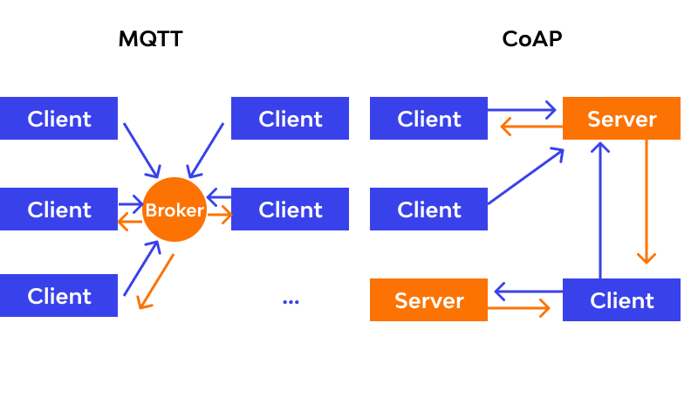
CoAP vs MQTT

Slide 21
CoAP | MQTT
Uses requests and responses | This model has publishers and subscribers as main participants
Message dispatching happens on a unicasting basis (one-to-one). The process is same as HTTP. | Central broker handles message dispatching, following the optimal publisher to client path.
Viable for state transfer | Event-oriented operations
Involved parties use UDP packets (async) for message passing and communication. | Establishing a continual and long-lasting TCP connection with the broker is essential for the client.
It defines messages properly and makes its discovery easy. | No message labeling but have to use diverse messages for different purposes.

Slide 22

Algorithms Based On Power Aware Protocol On IoT Framework

Slide 23
MOBILITY-AWARE ADAPTIVE FLOW-RULE PLACEMENT SCHEME IN SDN(Software Defined Network
INTRODUCTION:
Due to the advent of software-defined networking (SDN), it is getting attention among the networking researchers to support real-time application-specific requirements. In SDN, network-specific control strategies are defined by a centralized controller, while decoupling the control-plane and data-plane from the forwarding devices. The controller takes real-time control decisions based on the data received from the physical devices (considered as the data-plane).

Slide 24
Therefore, the control-plane can be configured according to requirements of end-users, without going into the vendor specific architecture of the physical devices. Thus, SDN based solution approaches are among the most promising to configure devices in real-time in order to meet application-specific requirements.
Concurrently, internet of things (IoT) is an emerging technology to digitize everything for the betterment of the connected world . Primary aim of IoT is to connect all network devices together and to control them in a unified manner. As a result, heterogeneous devices present in the network need to be interconnected and configured depending on the requirements. Further, the IoT devices are connected to the backbone network through access networks.

Slide 25
ALGORITHMS:
1.We propose a mobility-aware adaptive flow-rule placement scheme in Software Development Access Network.
2. We formulate a mixed integer linear problem (MILP) to minimize number of activated APs(access points) while considering capacity constraints of the APs and application-specific requirements of users in the network.
3. The proposed scheme consists of two components— path estimator and flow-manager—which are placed at the SDN controller end. The path estimator predicts the future locations of users, and the flow-manager implements the flow-rules at the APs, based on the predicted locations.

Slide 26
4. Use-case scenarios to present the suitability and practical applications of the proposed scheme from the perspectives of IoT. The proposed scheme does not introduce any client-side changes. Thus, it can be integrated with the existing SDN architecture.
5. Extensive simulation results show that the proposed scheme is beneficial to minimize network delay, number of activated APs, control overhead, and associated cost in rule placement, compared to the existing schemes.
6. Nguyen et al. proposed a general optimization framework for rule placement based on the Open Flow protocol. In such a scheme, the under-utilized forwarding devices are utilized first, depending on the number of allocated rules at them. Therefore, the forwarding devices with minimum number of flow-rules occupied are prioritized over the maximum occupied ones.

